Slide 1



TEN-T Priority Route Improvement Project, Donegal
Pre-Application Consultation Meeting
An Bord Pleanála
2nd September 2021

Slide 2
TEN-T Priority Route Improvement Donegal : Project Team - Attendees
Applicant: Donegal County Council
Presenters | Damian McDermott | A/Senior Engineer, Donegal County Council
 | Áine McHugh Tim Patterson | A/Senior Executive Engineer, Donegal County Council Project Manager, RPS|Barry Transportation JV
 | Eamon Cox Eamon Daly | Project Manager, RPS|Barry Transportation JV Project Manager, RPS|Barry Transportation JV
Attendees | Patrick Duffy | Regional Manager, Transport Infrastructure Ireland
 | Brendan O’Donnell | A/Director of Roads and Transportation
 | Paul Christie | Senior Executive Planner, Donegal County Council
 | Emma Coyle | RPS|Barry Transportation JV

Slide 3
Agenda
1.0 | Introductions
2.0 | Project Update Status Project Details
3.0 | ‘Walk Throughs’ Section 1 - N15 / N13 Ballybofey / Stranorlar Section 2 – N13 Letterkenny / Manorcunningham Section 3 – N14 Manorcunningham / Lifford
4.0 | Discussion

Slide 4
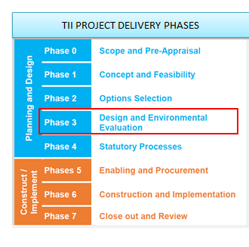
Project Update - Status
Approximately 300+ one to one meetings with landowners held July / August. Landowner meetings continue to progress
Draft CPO underway
Environmental Assessment progressing
Design being finalised

Slide 5
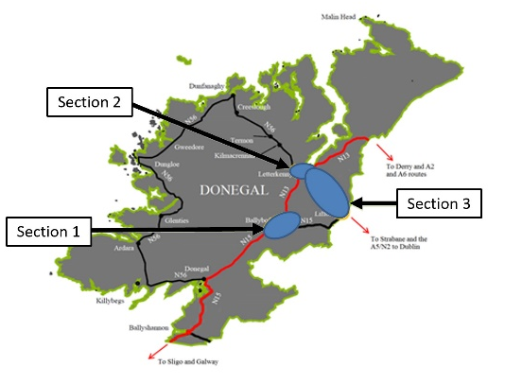
Scheme Details
Details | Section 1 | Section 2 | Section 3
Mainline length and Cross Section | 8.5km Type 2 DC + 1.1km Type 1 SC | 3.8km Type 1 DC + 5.1km Type 2 DC | 17.5km Type 2 DC
Link Road / Primary Road Connectors Length | 5.7km Type 1 / 2 SC | 0.6km Type 2 DC | 2km Type 2 SC
Active Travel Network length | 16km | 14km | 21km
Park & Share/Cycle Sites | 3 | 2 | 3
No. Mainline Interchanges | 3 | 1 | 3
No. Mainline Roundabouts | 3 | 4 | 2
No. Bridge & Underpass Structures (standard/typical) | 18 | 12 | 23
No. Bridge Structures (major) | One river bridge Length 360m | One river bridge Length 240m | One river bridge Length 280m

Slide 6
Walk Throughs

Slide 7
DISCUSSION

